Slide 1
Cab Investment analysis
Here is where your presentation begins

Slide 2
Overview
Company XYZ ,due to remarkable growth in the Cab Industry in last few years and multiple key players in the market,
it is planning for an investment in Cab industry and as per their Go-to-Market(G2M) strategy
they want to understand the market before taking final decision

Slide 3
Problem Statement
The Company aims to maximise profit on the Cab Industry by choosing the firm which has the maximum return.

Slide 4
Objectives
- Identify which company has a higher profit margin - Which city has the highest demand - To identify how customers of different ages use the cabs - To find out which cab has the highest demand

Slide 5
Data understanding
- We used four datasets:
Cab_Data.csv, Customer_ID.csv,City.csv, Transaction_ID.csv
We merged the data and the result had 14 columns and 359392 rows
The data has no missing data and no duplicates
We feature engineered the profit , age group, income group columns

Slide 6
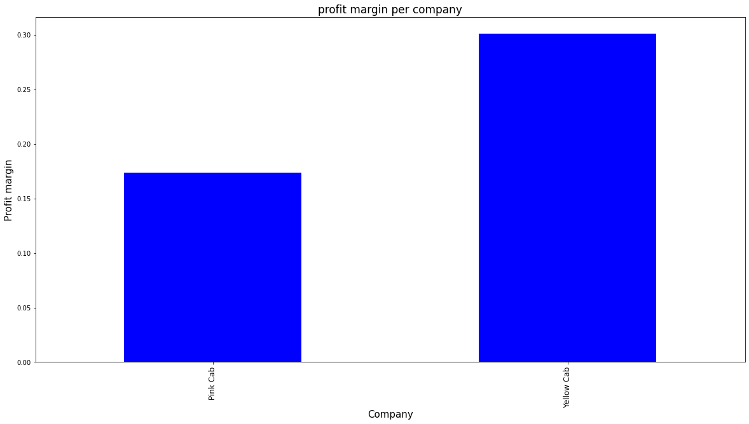
Profit margin per company
The yellow cab has a higher profit margin of 30 percent
The pink cab has a profit margin of approximately 18 percent

Slide 7
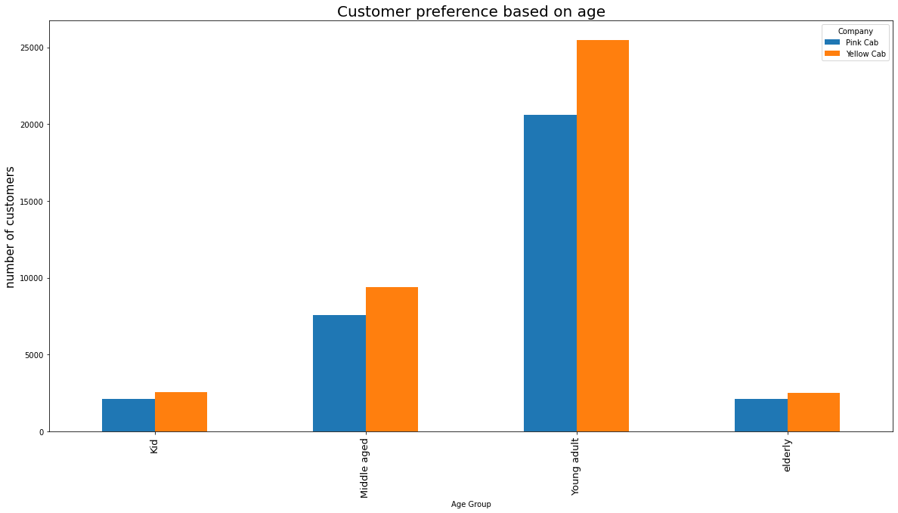
Customer preference based on age
Most customers in both companies were young adults aroung the age of 20 to 40 years

Slide 8
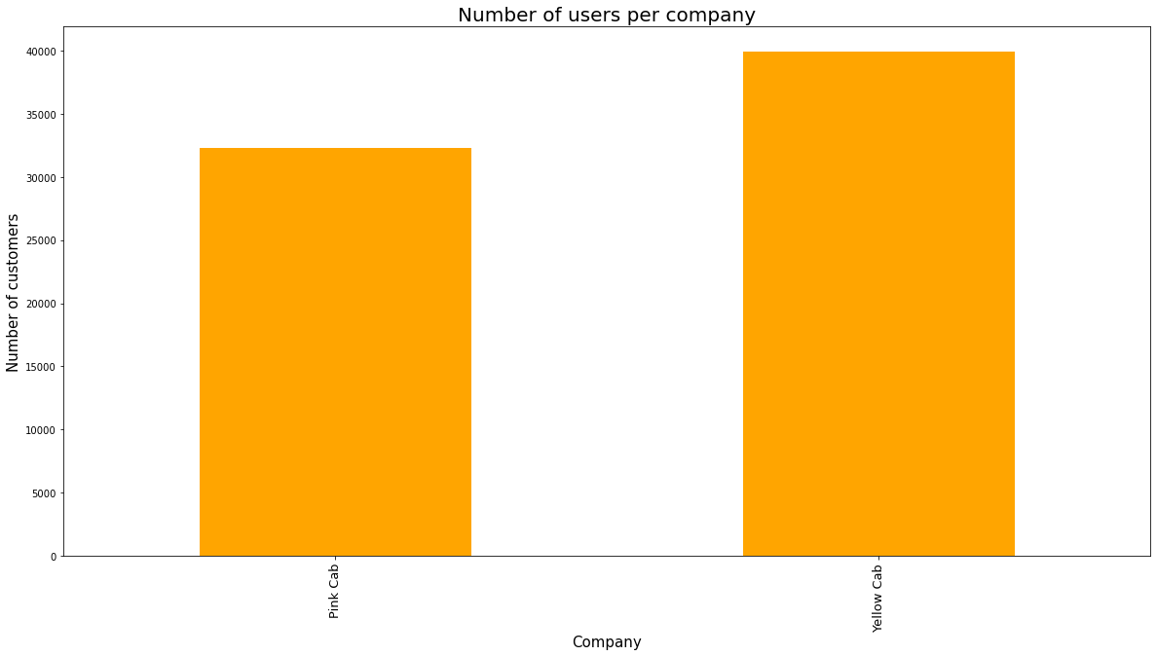
Number of users per company
The yellow cab has a higher number of users approximately 40,000
The pink cab has the least customers approximately 32,500

Slide 9
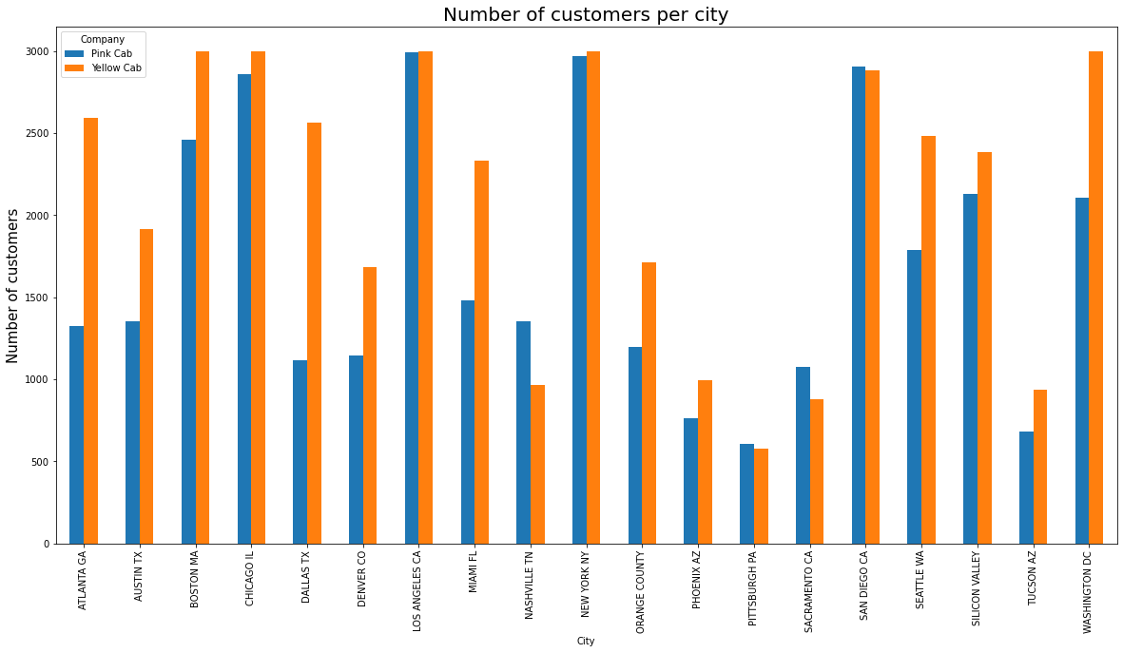
Customer preference based on age
The yellow cab has greater reach than the pink cab in the 15 cities
The pink cab has greater market reach than yellow cab in only four cities

Slide 10
Conclusion
Yellow Cab has a higher rate of return than Pink cab
The yellow cab has a greater profit margin in 18 cities than the pink cab
The pink cab has a greater profit margin in TUSCON AZ than the yellow cab only
The yellow cab had a higher number of users than the Pink Cab
Most Transactions were made through card payments followed by cash so offer card payment services across all cities
New york city has the most number of users followed by Chicago
Yellow cab has the highest number of users in New york city

Slide 11
Recommendation
We suggest choosing the yellow cab company over the pink cab.
The yellow company has more customers and higher rate of return

